Slide 1

IoTT
Internet of Toy Trains
© 2018 Hans R. Tanner
Nextion NX4024T032_011 3.5”
480 x 320 px

Slide 2

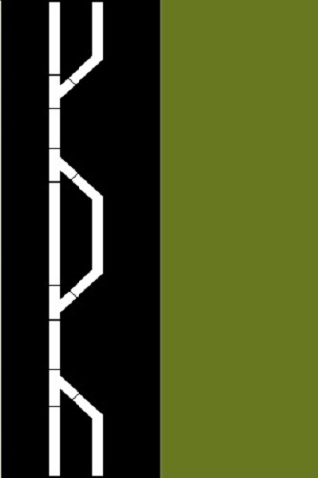
No Locomotive selected
No Locomotive selected

Slide 4
1
1
2
2
3
3
CANCEL
CANCEL
4
4
5
5
6
6
CLEAR
CLEAR
7
7
8
8
9
9
ENTER
ENTER
0
0
←
←

